Slide 1
Final Project:
Applied Data Science Capstone
From: Coursera | IBM

Slide 2
Executive Summary
Virgin Galactic is providing suborbital spaceflights. Rocket Lab is a small satellite provider. Blue Origin manufactures sub-orbital and orbital reusable rockets. Perhaps the most successful is SpaceX. SpaceX’s accomplishments include: Sending spacecraft to the International Space Station. Starlink, a satellite internet constellation providing satellite Internet access. Sending manned missions to Space. One reason SpaceX can do this is the rocket launches are relatively inexpensive. SpaceX advertises Falcon 9 rocket launches on its website with a cost of 62 million dollars; other providers cost upwards of 165 million dollars each, much of the savings is because SpaceX can reuse the first stage. Therefore, if we can determine if the first stage will land, we can determine the cost of a launch. Spaces X’s Falcon 9 launch like regular rockets. To help us understand the scale of the Falcon 9, we are going to use these diagrams from Forest Katsch, at zlsadesign.com. He is a 3D artist and software engineer. He makes infographics on spaceflight and spacecraft art. He also makes software. The payload is enclosed in the fairings.

Slide 3
The payload is enclosed in the fairings. Stage two, or the second stage, helps bring the payload to orbit, but most of the work is done by the first stage. The first stage is shown here. This stage does most of the work and is much larger than the second stage. Here we see the first stage next to a person and several other landmarks. This stage is quite large and expensive. Unlike other rocket providers, SpaceX's Falcon 9 Can recover the first stage. Sometimes the first stage does not land. Sometimes it will crash as shown in this clip. Other times, Space X will sacrifice the first stage due to the mission parameters like payload, orbit, and customer. In this capstone, you will take the role of a data scientist working for a new rocket company. Space Y that would like to compete with SpaceX founded by Billionaire industrialist Allon Musk. Your job is to determine the price of each launch. You will do this by gathering information about Space X and creating dashboards for your team. You will also determine if SpaceX will reuse the first stage. Instead of using rocket science to determine if the first stage will land successfully, you will train a machine learning model and use public information to predict if SpaceX will reuse the first stage.

Slide 4
Introduction
As a starting point of almost all data science projects, you need to collect data, as much and relevant as possible.
You will be collecting data from various sources. After your raw data has been collected, you will need to improve the quality by performing data wrangling.
Then you can start exploring the processed data. We will be your guide as we explore some really interesting real-world datasets together. You'll get to practice your SQL skills as we query the data and gather insights.
You'll gain further insights into the data by applying some basic statistical analysis and data visualization, you'll be able to see directly how variables might be related to each other.
We'll drill down into finer levels of detail by splitting the data into groups defined by categorical variables or factors in your data.
You will be guided to build, evaluate, and refine predictive models for discovering more exciting insights.
Executive Summary
Introduction
Data collection and data wrangling methodology
EDA and interactive visual analytics methodology
Predictive analysis methodology
EDA with visualization
EDA with SQL
Interactive map with Folium
Plotly Dash dashboard
Predictive analysis (classification)
Conclusion

Slide 5
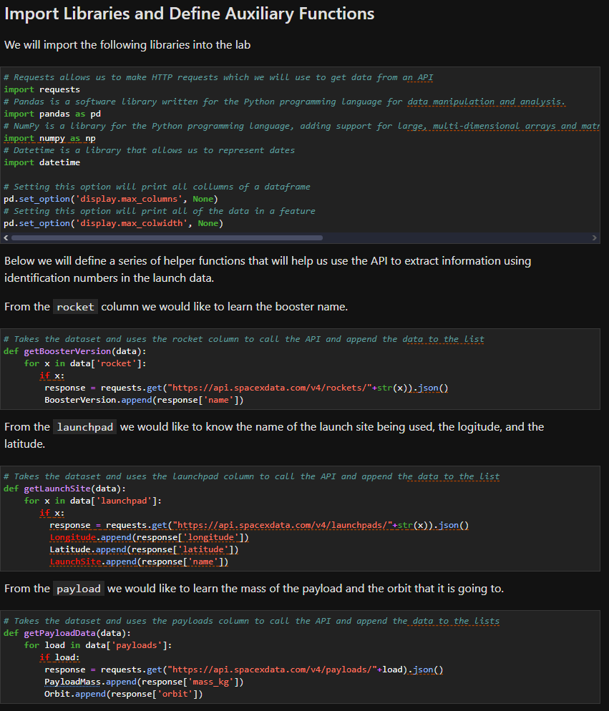
data collection and data wrangling methodology related
In this capstone, we will predict if the Falcon 9 first stage will land successfully. SpaceX advertises Falcon 9 rocket launches on its website with a cost of 62 million dollars; other providers cost upward of 165 million dollars each, much of the savings is because SpaceX can reuse the first stage. Therefore if we can determine if the first stage will land, we can determine the cost of a launch. This information can be used if an alternate company wants to bid against SpaceX for a rocket launch. In this lab, you will collect and make sure the data is in the correct format from an API. The following is an example of a successful and launch.

Slide 6
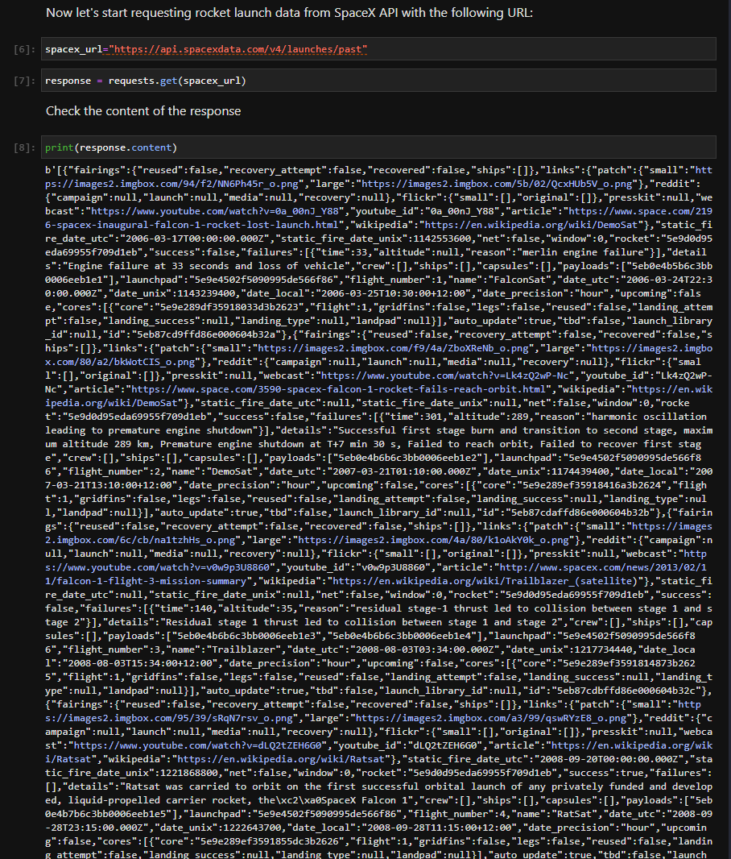
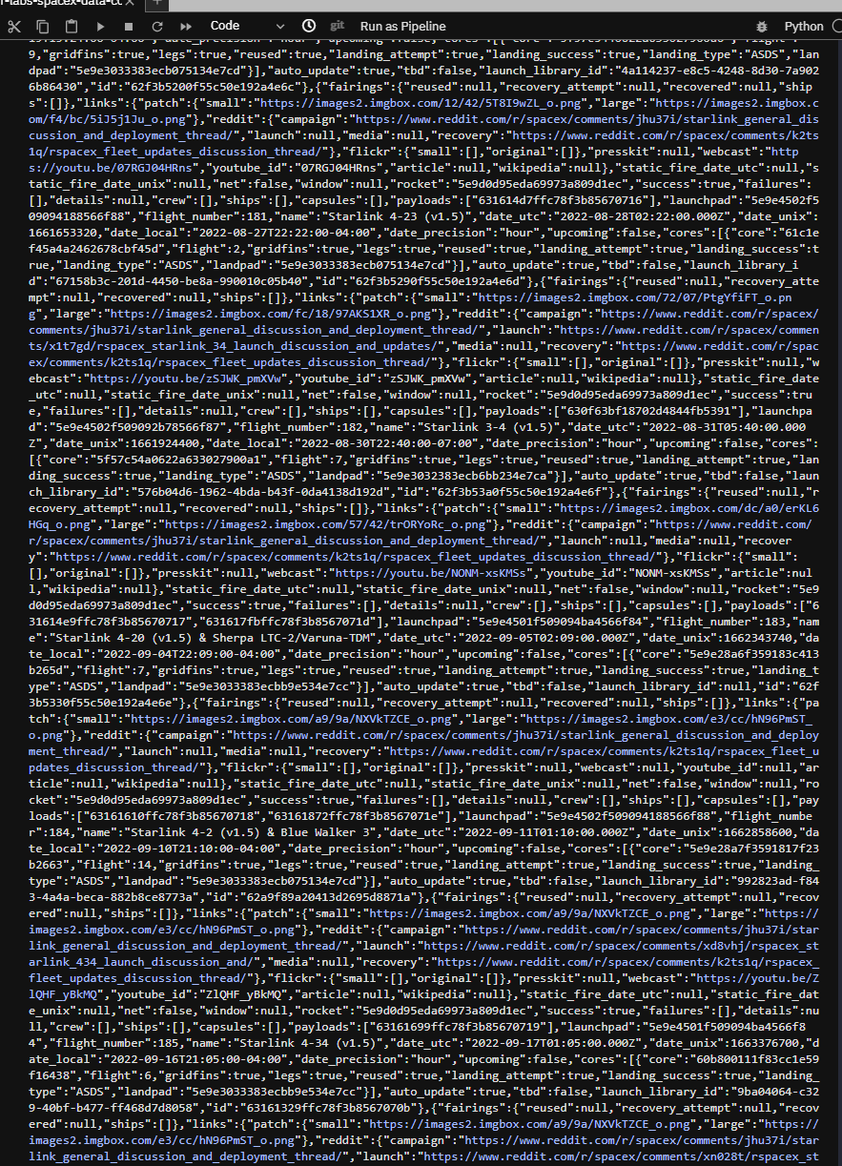
You should see the response contains massive information about SpaceX launches.
Next, let's try to discover some more relevant information for this project.

Slide 7
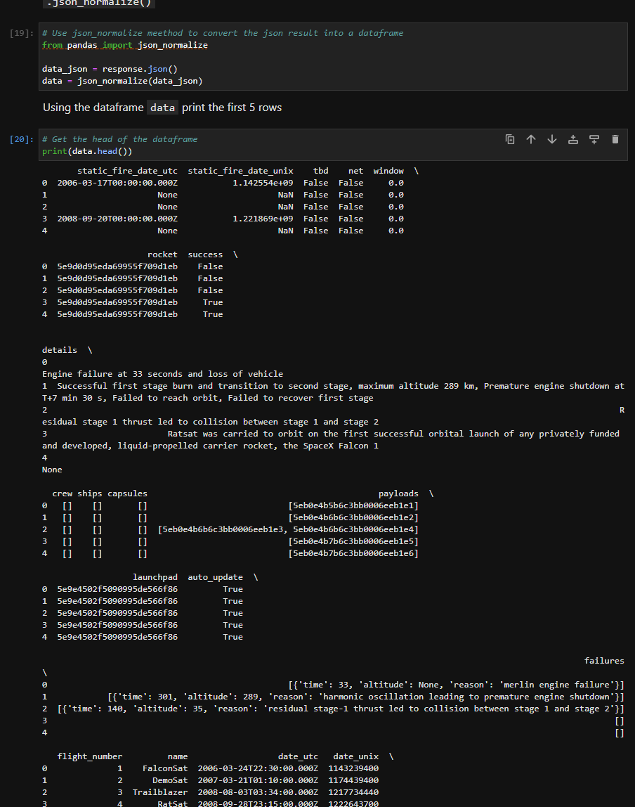
Task 1: Request and parse the SpaceX launch data using the GET request
To make the requested JSON results more consistent, we will use the following static response object for this project:
We should see that the request was successfull with the 200 status response code

Slide 8
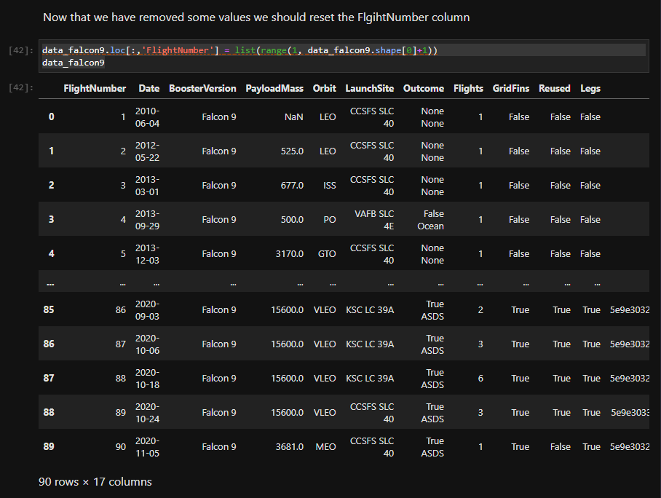
Task 2: Filter the dataframe to only include Falcon 9 launches
Finally we will remove the Falcon 1 launches keeping only the Falcon 9 launches. Filter the data dataframe using the BoosterVersion column to only keep the Falcon 9 launches. Save the filtered data to a new dataframe called data_falcon9.

Slide 9
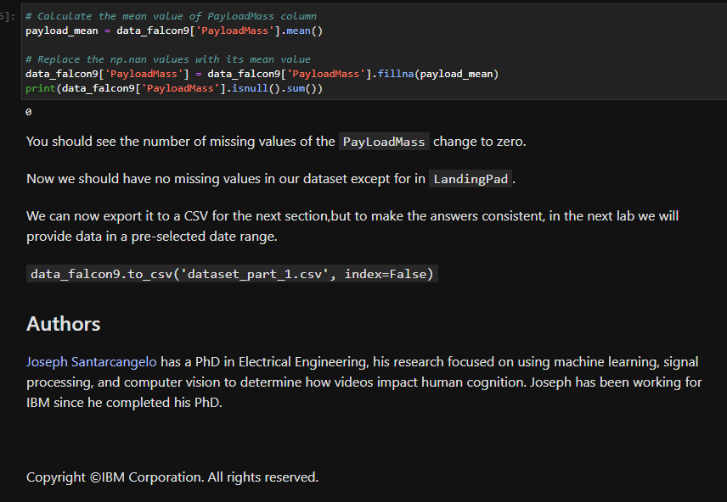
Task 3: Dealing with Missing Values
Calculate below the mean for the PayloadMass using the .mean(). Then use the mean and the .replace() function to replace np.nan values in the data with the mean you calculated.

Slide 10
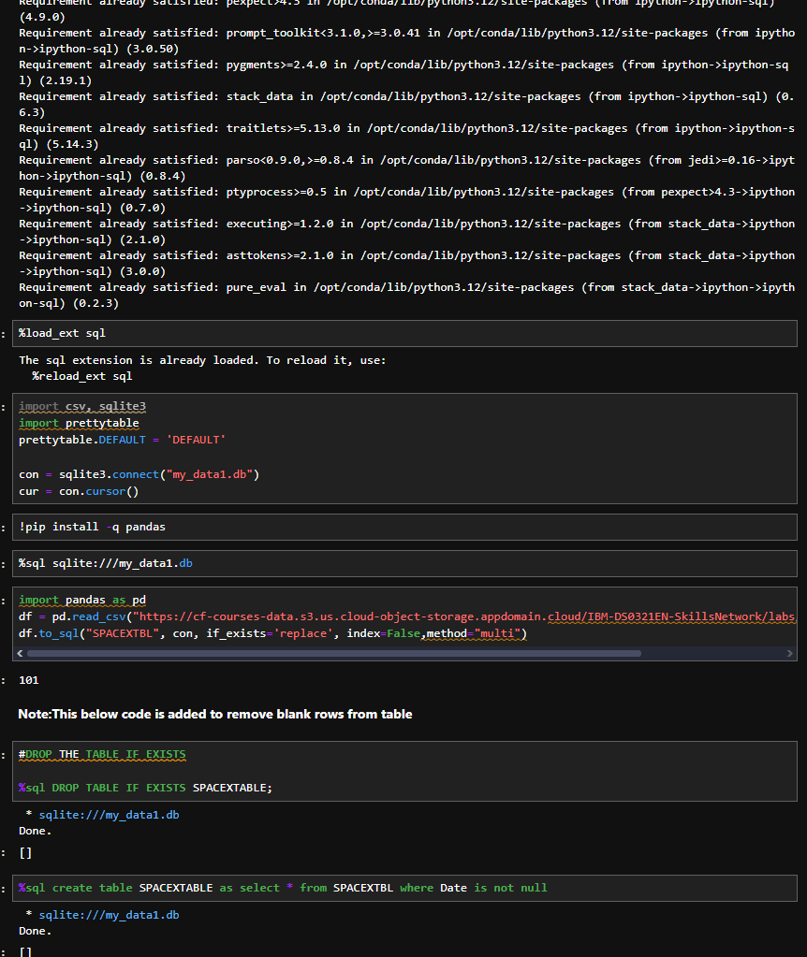
EDA and interactive visual analytics methodology related
SpaceX has gained worldwide attention for a series of historic milestones.
It is the only private company ever to return a spacecraft from low-earth orbit, which it first accomplished in December 2010. SpaceX advertises Falcon 9 rocket launches on its website with a cost of 62 million dollars wheras other providers cost upward of 165 million dollars each, much of the savings is because Space X can reuse the first stage.
Therefore if we can determine if the first stage will land, we can determine the cost of a launch.
This information can be used if an alternate company wants to bid against SpaceX for a rocket launch.
This dataset includes a record for each payload carried during a SpaceX mission into outer space.

Slide 11
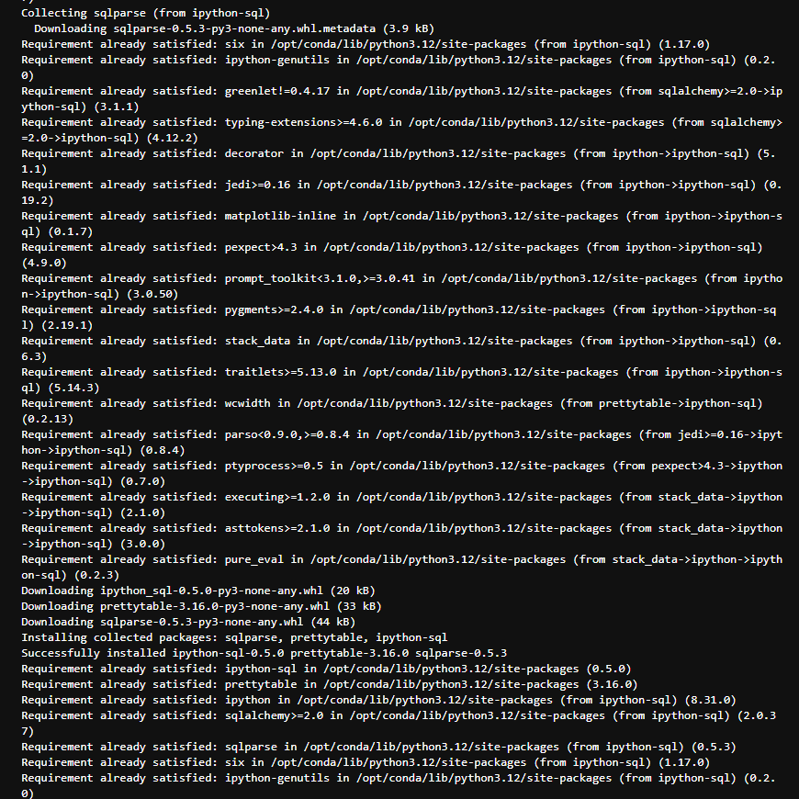
We see that different launch sites have different success rates. As a result, they can be used to help determine if the first stage will land successfully. CCAFS LC-40 has a success rate of 60%, while KSC LC-39A and VAFB SLC 4E have a success rate of around 77%. Combining attributes also gives us more information. If we overlay the result of the landing outcomes as a color we see that CCAFS LC-40, has a success rate of 60%, but if the mass is above 10,000 kg the success rate is 100%. Therefore, we will combine multiple features. In the lab, you will determine what attributes are correlated with successful landings.

Slide 12
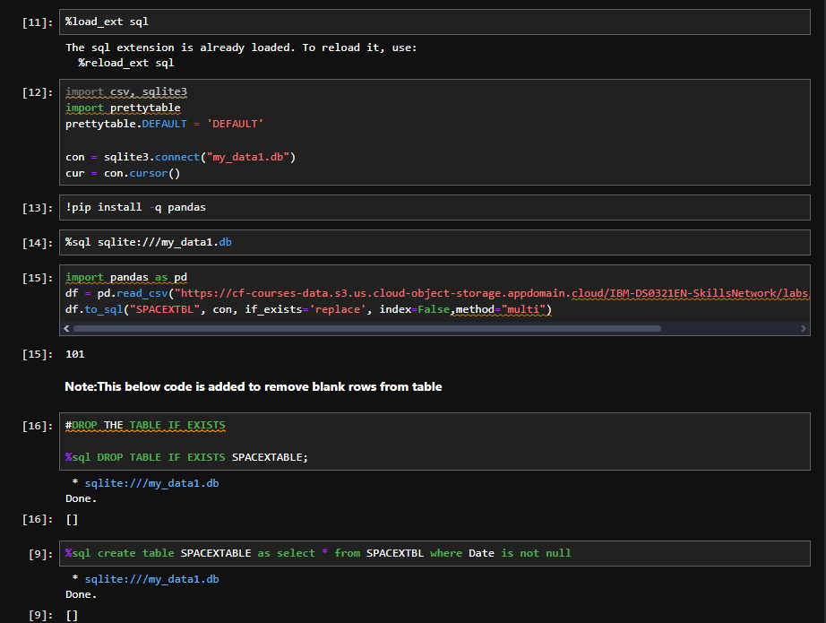
predictive analysis methodology related
Skills Network Labs (SN Labs) is a virtual lab environment used in this course. Upon clicking the "Launch App" button below, your Username and Email will be passed to SN Labs and will be used in strict accordance with IBM Skills Network Privacy policy, such as for communicating important information to enhance your learning experience.

Slide 14
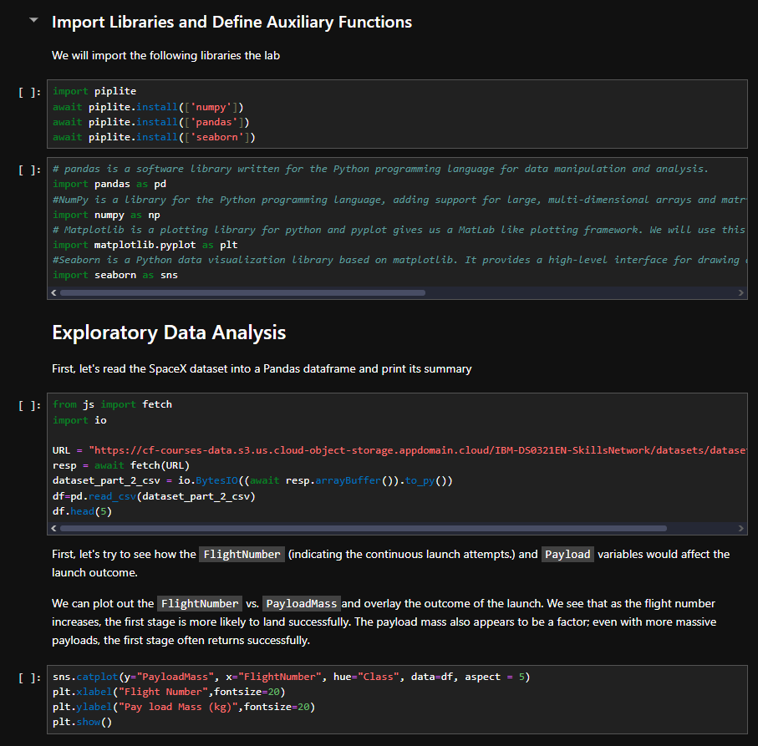
EDA with visualization results
In this assignment, we will predict if the Falcon 9 first stage will land successfully. SpaceX advertises Falcon 9 rocket launches on its website with a cost of 62 million dollars; other providers cost upward of 165 million dollars each, much of the savings is due to the fact that SpaceX can reuse the first stage.
In this lab, you will perform Exploratory Data Analysis and Feature Engineering.

Slide 15
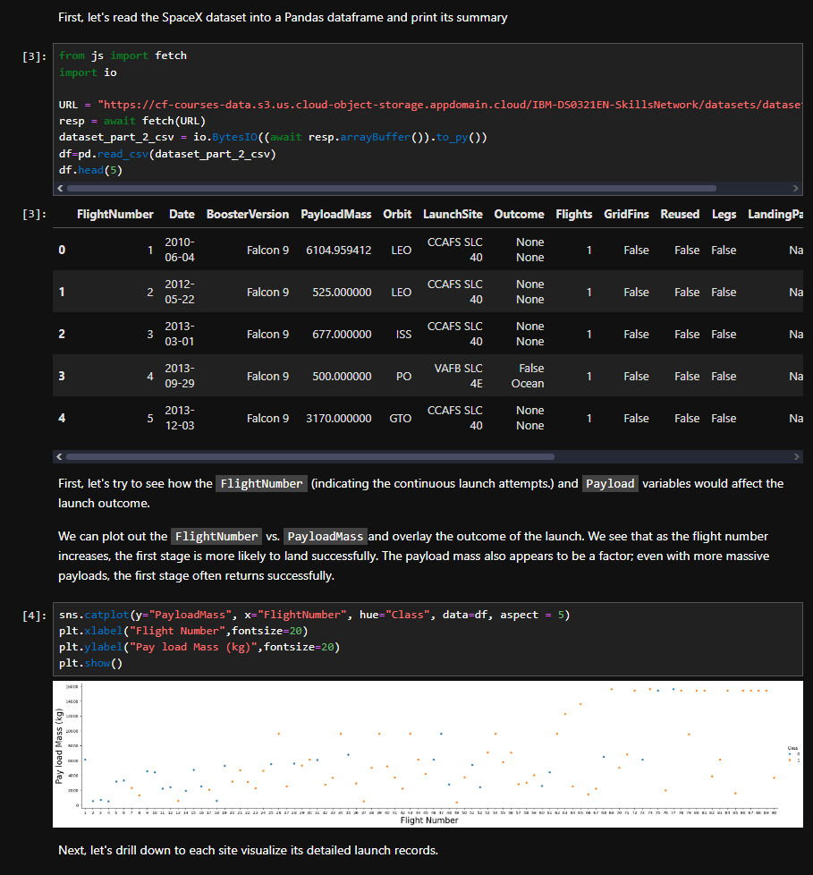
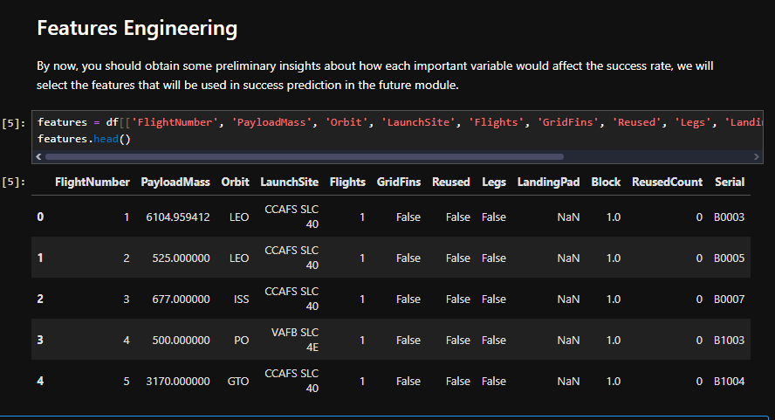
EDA with SQL results

Slide 16

interactive map with Folium results
The launch success rate may depend on many factors such as payload mass, orbit type, and so on. It may also depend on the location and proximities of a launch site, i.e., the initial position of rocket trajectories. Finding an optimal location for building a launch site certainly involves many factors and hopefully we could discover some of the factors by analyzing the existing launch site locations.
In the previous exploratory data analysis labs, you have visualized the SpaceX launch dataset using matplotlib and seaborn and discovered some preliminary correlations between the launch site and success rates. In this lab, you will be performing more interactive visual analytics using Folium.

Slide 17
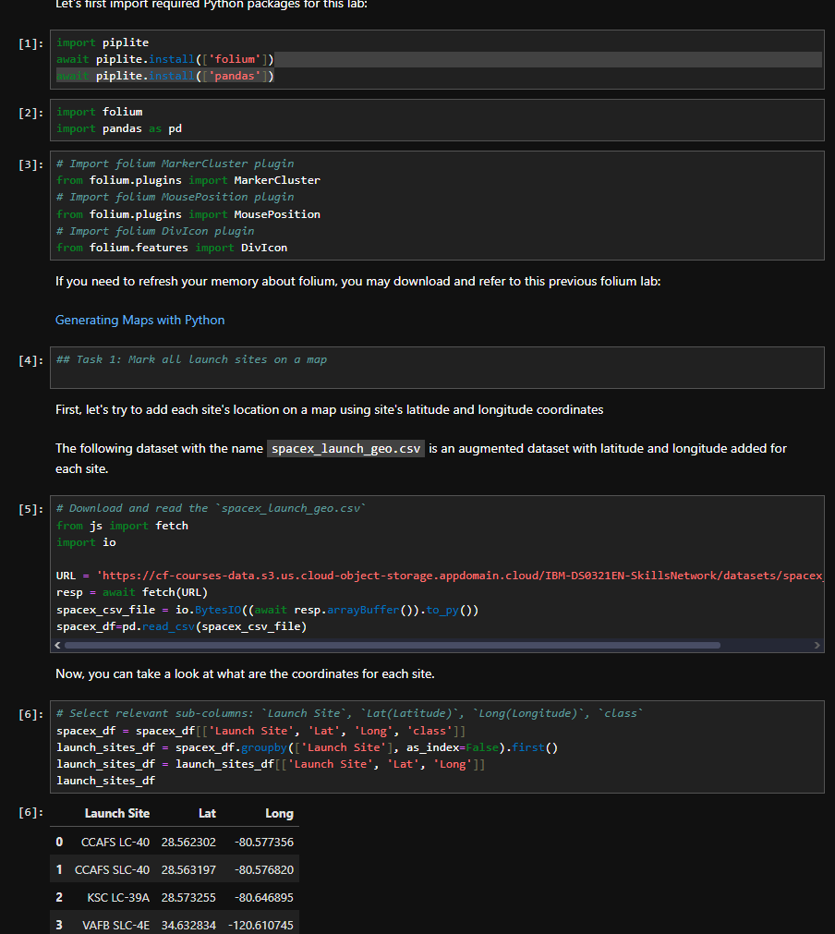
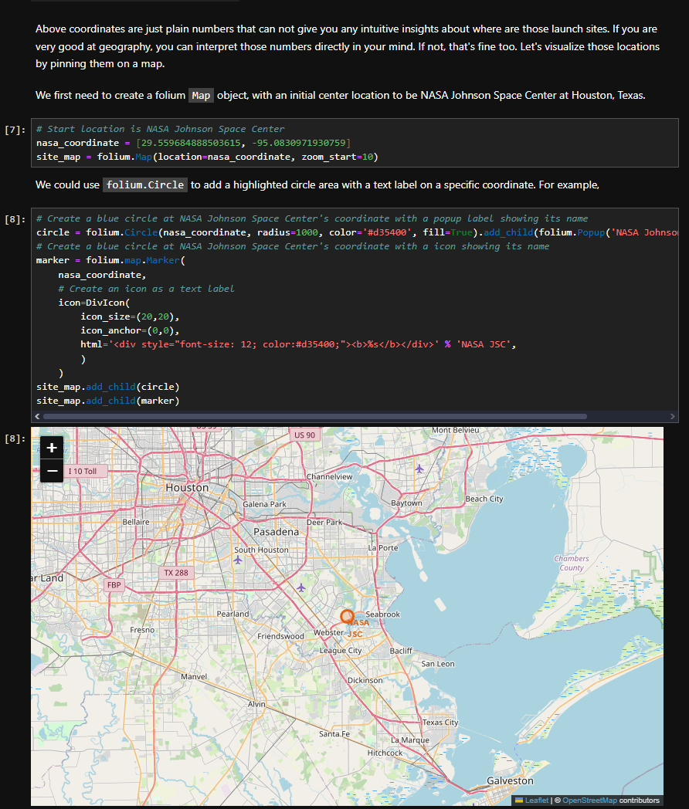

Slide 18
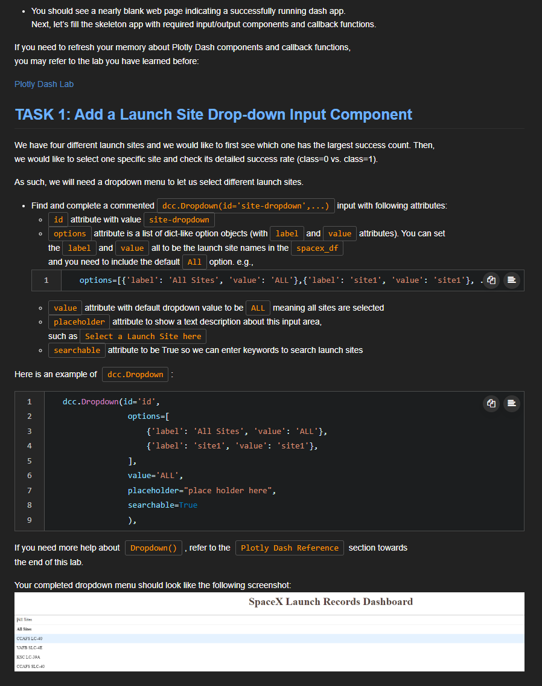
Plotly Dash dashboard results
In this lab, you will be building a Plotly Dash application for users to perform interactive visual analytics on SpaceX launch data inreal-time.
This dashboard application contains input components such as a dropdown list and a range slider to interact with a pie chart and a scatter point chart.
We have four different launch sites and we would like to first see which one has the largest success count. Then, we would like to select one specific site and check its detailed success rate (class=0 vs. class=1).
The general idea of this callback function is to get the selected launch site from site-dropdown and render a pie chart visualizing launch success counts. Dash callback function is a type of Python function which will be automatically called by Dash whenever receiving an input component updates, such as a click or dropdown selecting event.

Slide 19
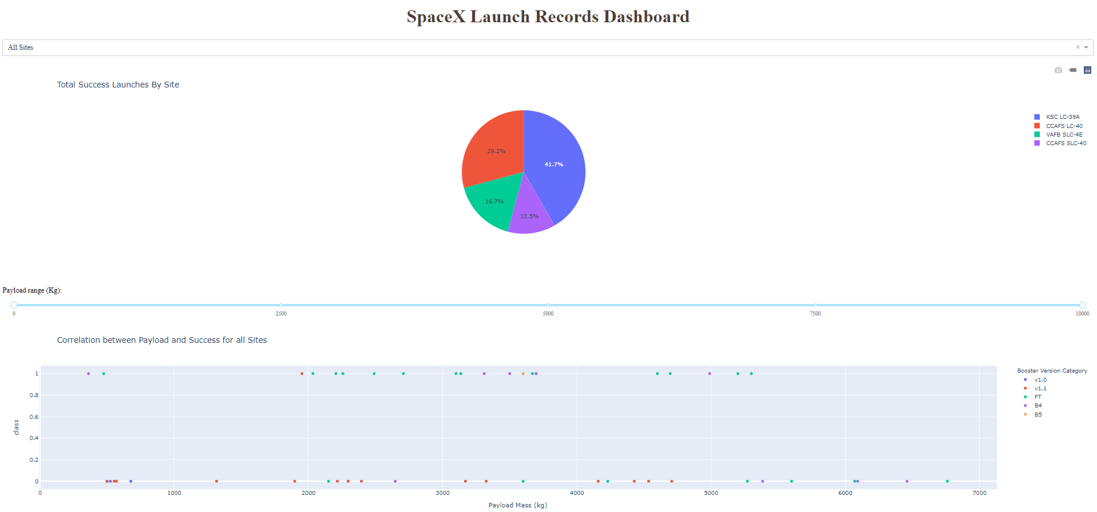
Next, we want to find if variable payload is correlated to mission outcome. From a dashboard point of view, we want to be able to easily select different payload range and see if we can identify some visual patterns.
Next, we want to plot a scatter plot with the x axis to be the payload and the y axis to be the launch outcome (i.e., class column). As such, we can visually observe how payload may be correlated with mission outcomes for selected site(s).

Slide 20
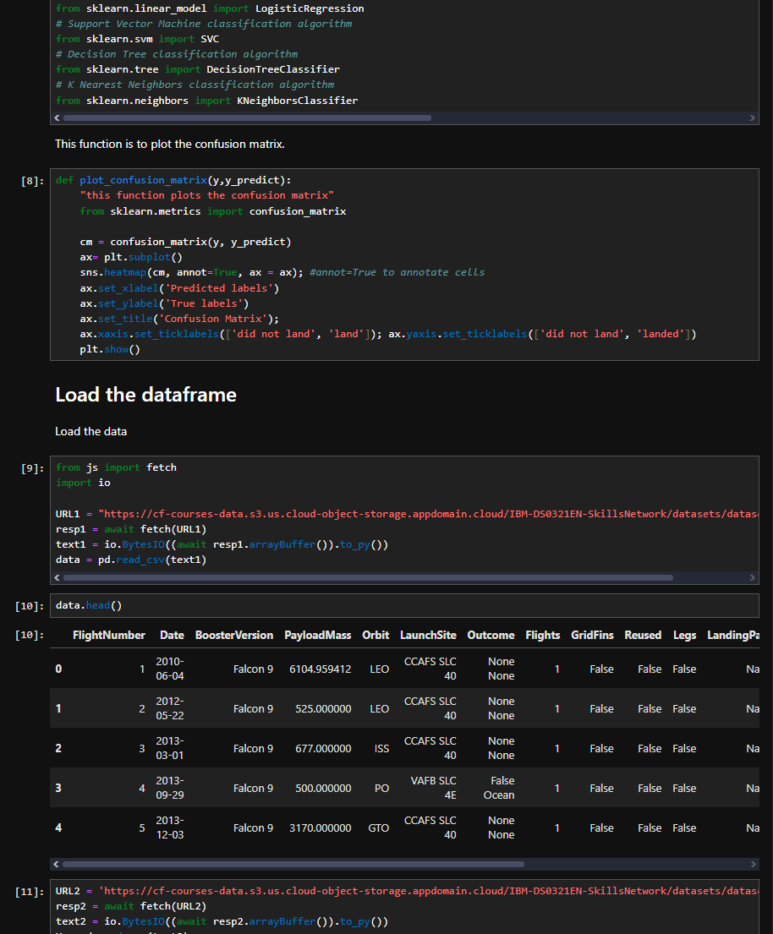
predictive analysis (classification) results
Space X advertises Falcon 9 rocket launches on its website with a cost of 62 million dollars; other providers cost upward of 165 million dollars each, much of the savings is because Space X can reuse the first stage. Therefore if we can determine if the first stage will land, we can determine the cost of a launch. This information can be used if an alternate company wants to bid against space X for a rocket launch. In this lab, you will create a machine learning pipeline to predict if the first stage will land given the data from the preceding labs.

Slide 21
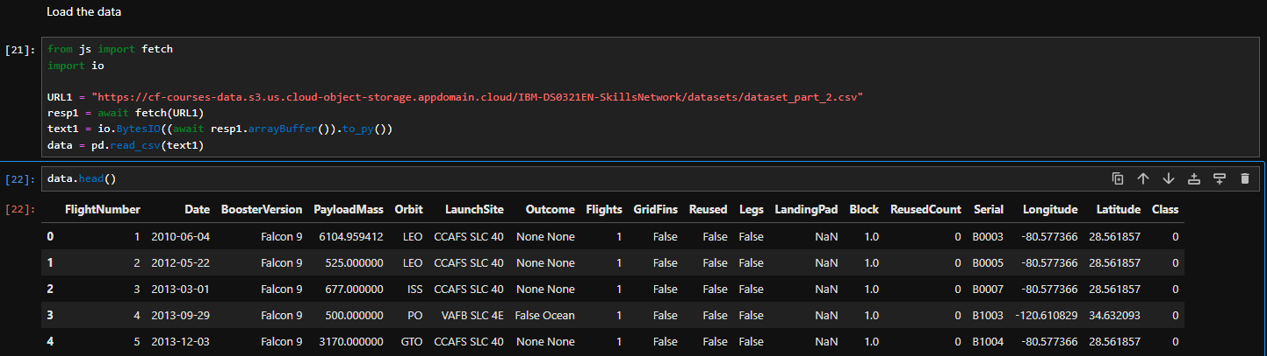
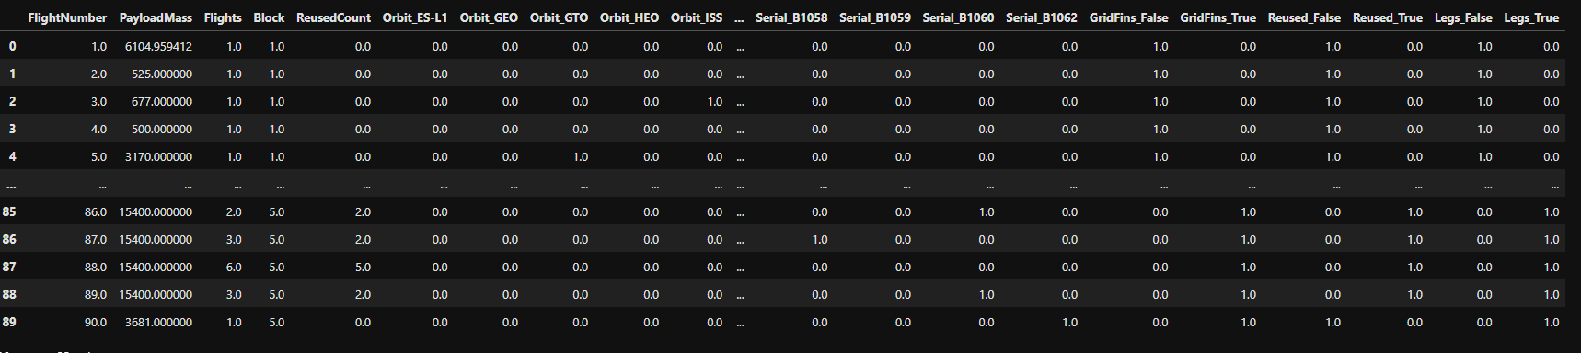

Slide 22
Conclusion
After all the work done we have: Preprocessing, allowing us to standardize our data, and Train_test_split, allowing us to split our data into training and testing data, We will train the model and perform Grid Search, allowing us to find the hyperparameters that allow a given algorithm to perform best. Using the best hyperparameter values, we will determine the model with the best accuracy using the training data. You will test Logistic Regression, Support Vector machines, Decision Tree Classifier, and K-nearest neighbors. Finally, we will output the confusion matrix.
Final Project IBM.odp:
https://github.com/MannyDevv/SN-Labs/blob/main/Final%20Project%20IBM.odp

